Slide 1
Link to Tableau public
Profile - suma.reddy | Tableau Public

Slide 2
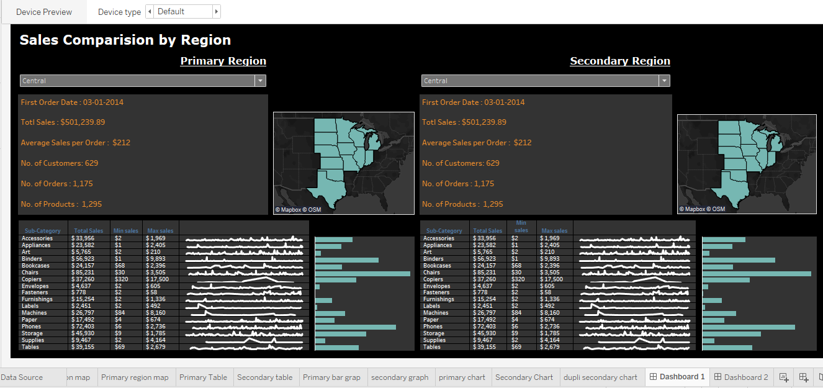
Central region

Slide 3
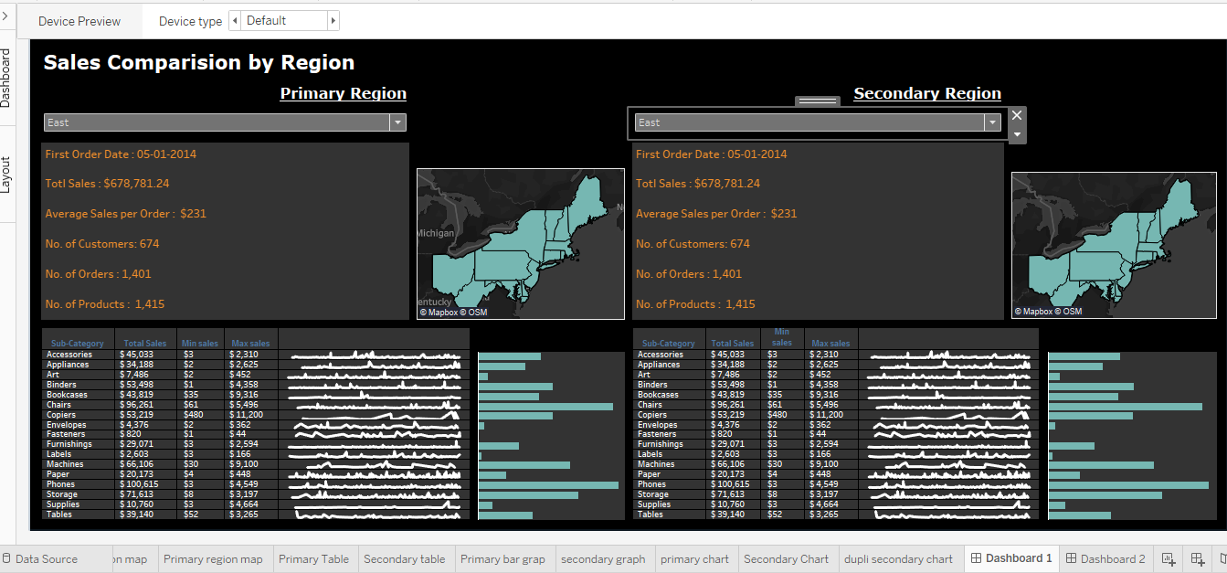
East region

Slide 4
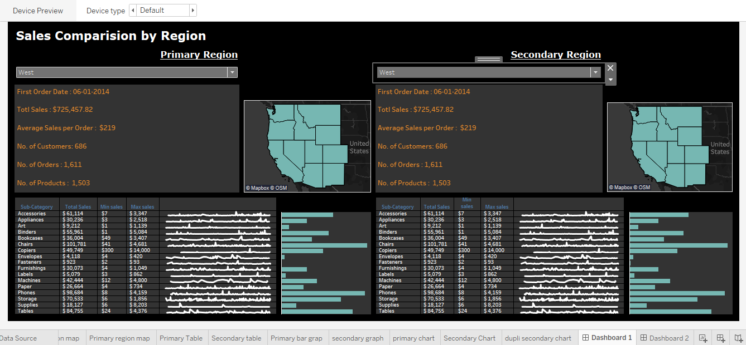
West region

Slide 5
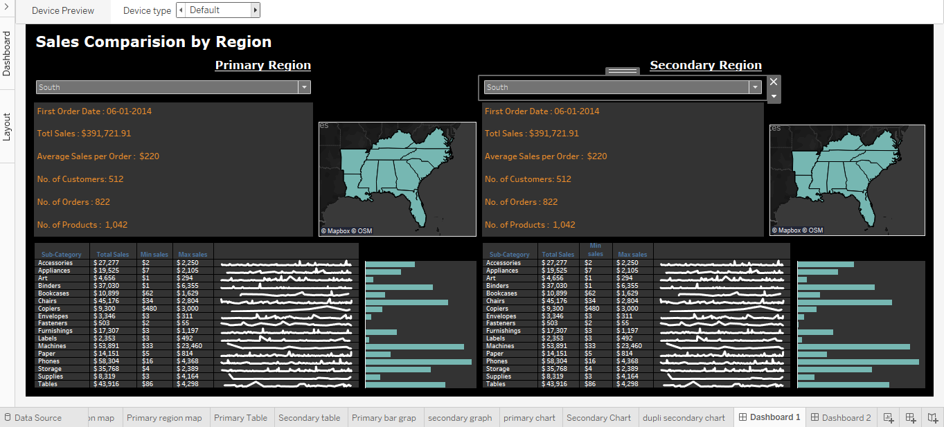
South region

